Slide 1

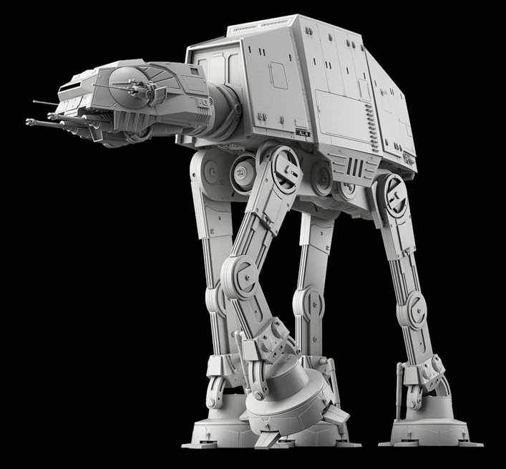
Homework 4
IS664 Database Programming
Spring 2021
Stored procedures

Slide 2
General
Create a single .sql script that contains all the code necessary to accomplish the specified tasks.
Name your submission file [your last name]HW4.sql
Utilize the namespace stormtrooper_java.
Create the specified user-defined functions.
Utilize the functions to create the specified stored procedure
Call the stored procedure with the specified arguments.

Slide 3

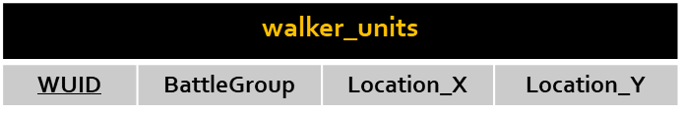
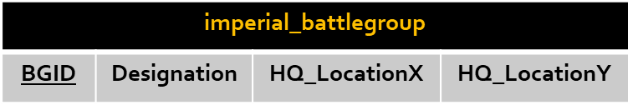
Relations Utilized
All the information needed to complete your exam is provided by these tables in the stormtrooper_java database.

Slide 4
Requirement: User-Defined Functions
Create the following user-defined functions.
CubicDisplacement
Purpose | Determine the cubic displacement of a specified Imperial Walker type
Input | Processing | Output
P1: Height P2: Length P3: Width P4: Walker Type | Calculates the cubic displacement (area) of an Imperial Walker utilizing the formulae: AT-AT = Height x Length x Width x 0.016 AT-ST = Height x Length x Width x 0.12 | Cubic Displacement of Imperial Walker
MassDisplacement
Purpose | Determine the mass displacement of a specified Imperial Walker type
Input | Processing | Output
P1: Cubic Displacement P2: Walker Type | Calculates the mass displacement (weight) of an Imperial Walker utilizing the formulae: AT-AT = Cubic Displacement x 64 AT-ST = Cubic Displacement x 72 | Mass Displacement of Imperial Walker

Slide 5
Requirement: User-Defined Functions
Create the following user-defined functions.
Endurance
Purpose | Determine the endurance of a specified Imperial Walker type
Input | Processing | Output
P1: Maximum Speed P2: OpRange P3: Mass Displacement P4: Walker Type | Calculates the operational endurance (time) of an Imperial Walker utilizing the formulae: AT-AT = (OPRange / MaximumSpeed) x MassDisplacement x 0.75 AT-ST = (OPRange / MaximumSpeed) x MassDisplacement x 0.35 | Endurance of Imperial Walker
MassEnduranceRatio
Purpose | Determine the mass endurance ratio of a specified Imperial Walker type
Input | Processing | Output
P1: Endurance P2: Mass Displacement P3: Walker Type | Calculates the mass endurance ratio (weight-time) of an Imperial Walker utilizing the formulae: AT-AT = MassDisplacement/Endurance x 0.89 AT-ST = MassDisplacement/Endurance x 1.11 | Mass Endurance Ratio of Imperial Walker

Slide 6
Requirement: User-Defined Functions
Create the following user-defined functions.
formattedJoin
Purpose | Concatenates two strings with a specified separator
Input | Processing | Output
P1: String P2: String P3: Separator | Concatenates two strings specified in the parameters by joining them together with the specified separator string specified in the parameters. | Formatted String
distanceTo
Purpose | Calculates the 2D Euclidean distance
Input | Processing | Output
P1: X1 Coordinate P2: Y1 Coordinate P3: X2 Coordinate P4: Y2 Coordinate | Calculates the 2D Euclidean distance between the two points specified in the parameters. | Euclidean Distance

Slide 7
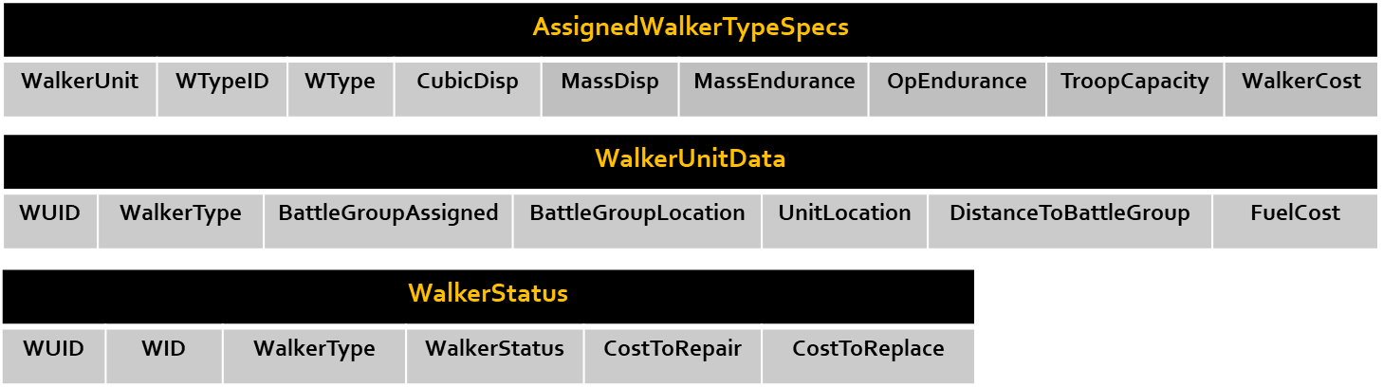
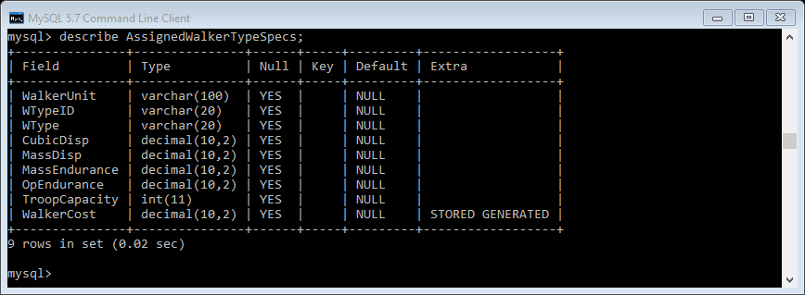
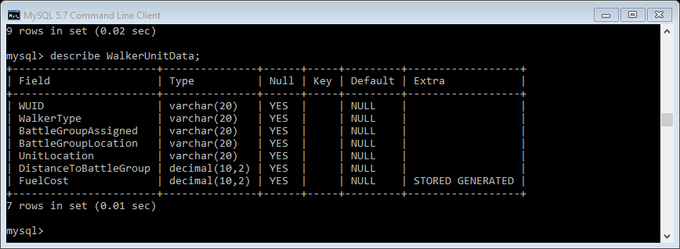
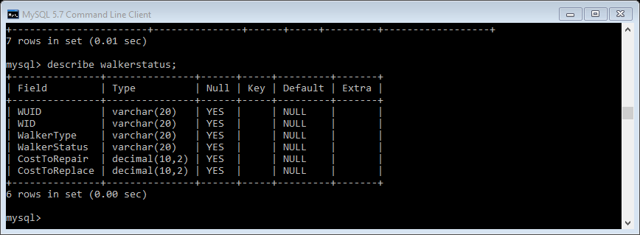
Requirement: Stored Procedure
Create a stored procedure WalkerOpSpecs which accepts a single parameter which is the WUID number of an Imperial Walker Unit and creates/displays the tables shown below:…SEE EXPECTED OUTPUT SLIDE FOR FORMAT
The cost of an Imperial Walker = MassDisplacement /CubicDisplacement x 8.7
The cost to replace an Imperial Walker = The cost of the Imperial Walker
The cost to repair an Imperial Walker = 35% of the cost to replace an Imperial Walker
Fuel cost = 4.7 x the distance of the Imperial Walker from its Battle Group
***All data retrieval and value calculation must be done through use of a Cursor contained within a loop
***No SELECT INTO statements may be utilized with the exception of the FOUND_ROWS() function.
***No values may be hard coded within the stored procedure with the exception of counter variables which may be initialized to 0.
***You may hard code values within any user-defined functions.

Slide 8
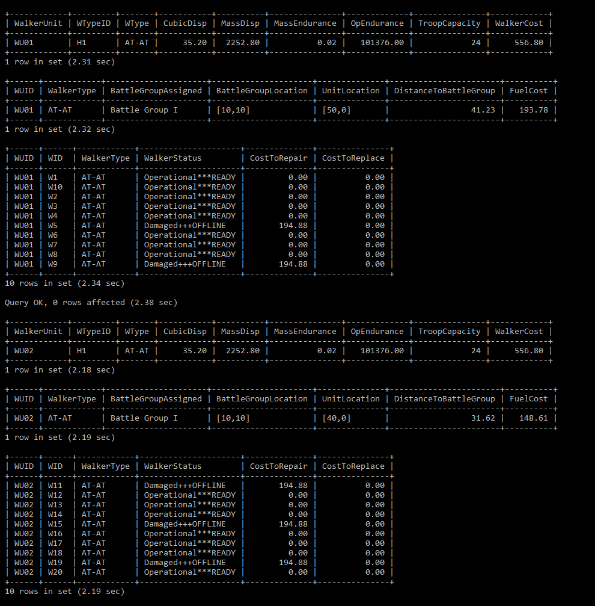
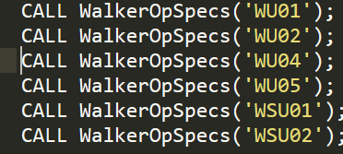
Expected Output
Call the procedure as shown

Slide 9
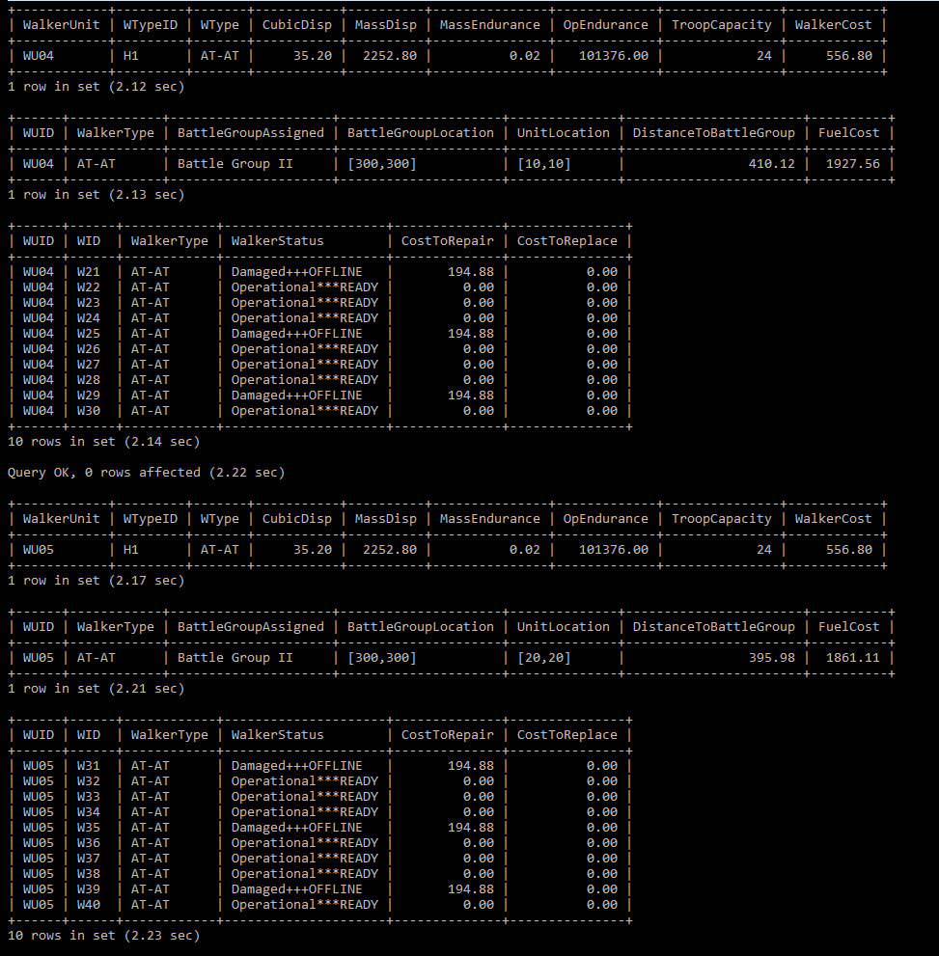
Expected Output
Call the procedure as shown

Slide 10
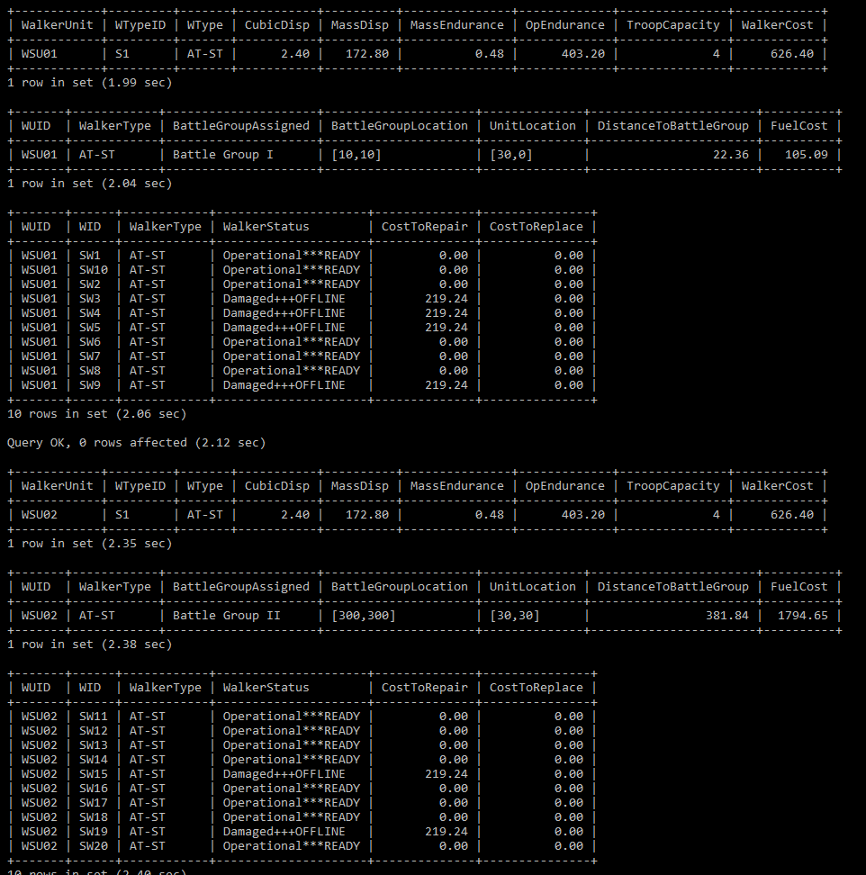
Expected Output
Call the procedure as shown

